Slide 1
Predicting Movie Revenue
Blake Hawes

Slide 2
Goal
Train a model to predict how much a movie will make, based off of only features known before the release of the movie
Predict the revenue of movies coming out the week of April 14th

Slide 3
Getting to Know the Data
Scraped from The Movie Database (TMDB)
1002 released films, 24 upcoming films
Columns: budget, genres, popularity, release_date, runtime, revenue
Goal: predict revenue from other variables

Slide 4
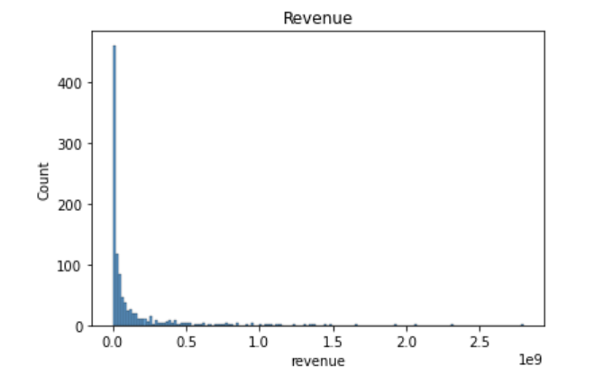
Revenue Distribution

Slide 5
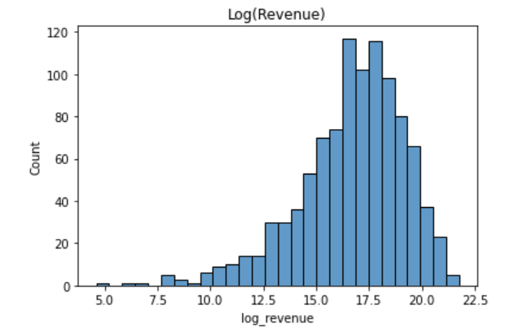
Log(revenue) Distribution

Slide 6
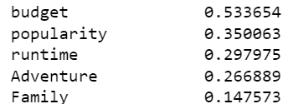
Highest Correlations to Log(revenue)

Slide 7
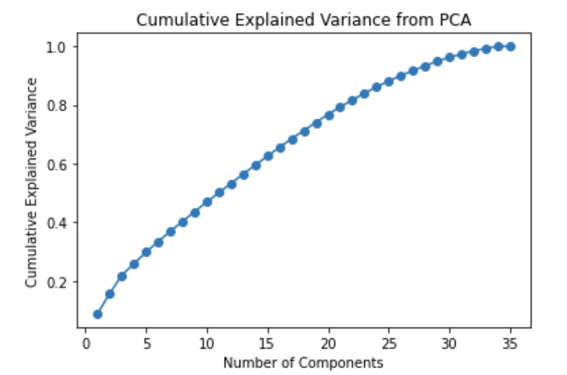
Preprocessing - PCA

Slide 8
Results
Model | Validation MSE | Test MSE
Linear Regression | 3.47 | 5.04
KNN | 4.09 | 5.97
Decision Tree | 4.75 | 6.41
Random Forest | 2.14 | 5.23
AdaBoost | 3.94 | 5.77
SVM | 2.99 | 4.95
Neural Network | 5.22 | 5.46
XGBoost | 1.74 | 3.92

Slide 9
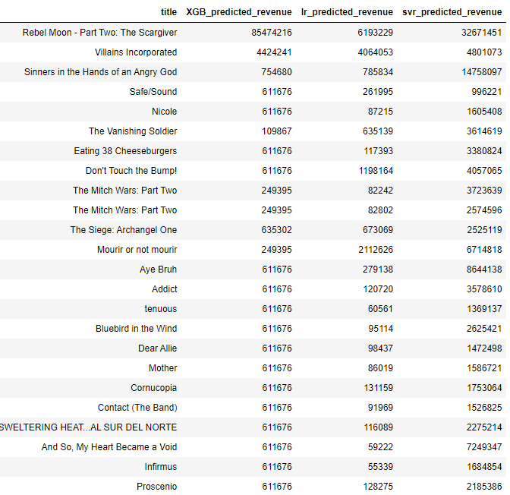
Predictions

Slide 10
Thank You!

